Slide 1
Basic of Deep learning
Bijay Gaudel

Slide 2
Qualification for certificate
All 3 days attendance
Full time participation
Assignment completion

Slide 3
AI/ML/DL
Artificial Intelligence
AI
System that thinks rationally
System That acts rationally
ML
Machine Learning
DL
Learns from data rather than explicitly programmed
Deep Learning
Inspired from structure and function of brain

Slide 4
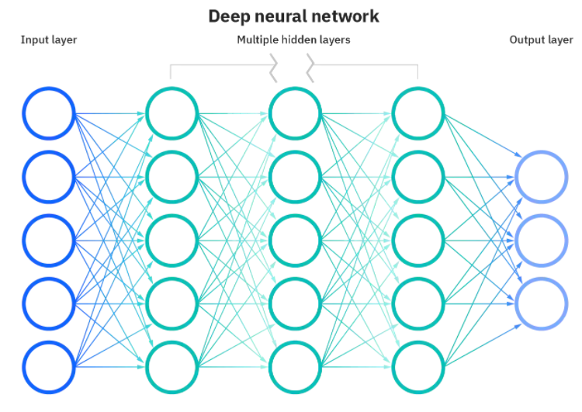
Basic of NN
Neuron
Input Layer
Hidden Layer
Output Layer
Training
Validation
Testing
Activation Function
Cost function
Learning Rate
Optimization
Local Minima
Global Minima
Evaluation Metrices
Fig: Deep Neural Network
Source: https://www.ibm.com/cloud/learn/neural-networks

Slide 5
How do NN works?
Model
Cost Function
Optimization

Slide 6
Model
Output of the machine learning algorithms run on a data
Algorithms results in a model comprised of vector or coefficient of weights and bias with specific values
Data + Prediction Algorithm = Model

Slide 7
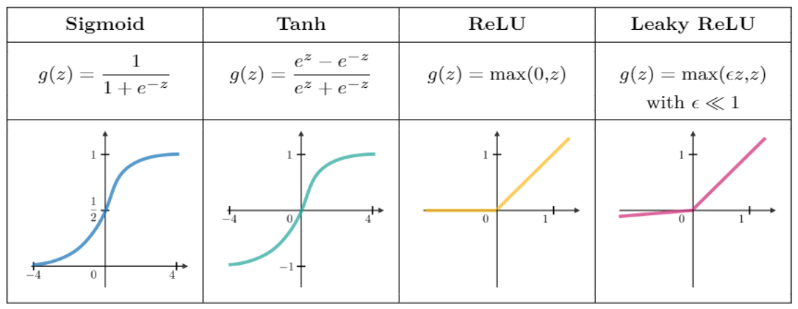
Activation function

Slide 8
Cost/Loss function
Measure of error between what actually is and what our model predicts
Entire model => Cost function
Single Epoch => Loss function
Types
Regression Loss Function
Binary Classification Loss Function
Multi-class Classification Loss Function

Slide 9
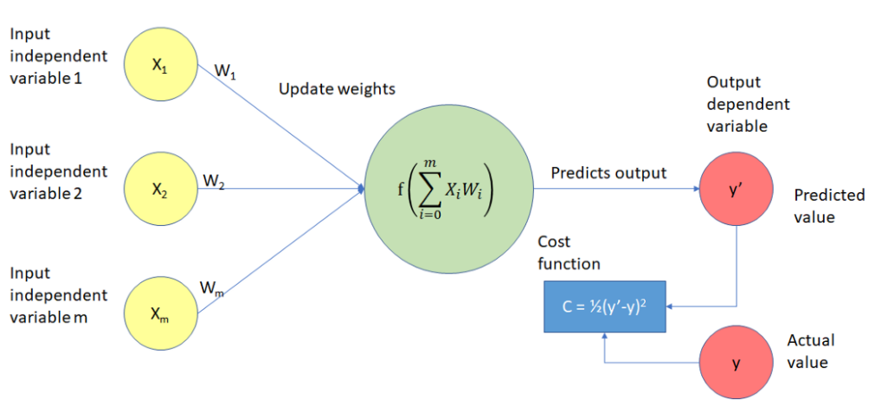
Cost/Loss function

Slide 10




Optimization Process
Cross entropy loss :
Learning rate:
Indicate at which pace the weight get updated. Can be fixed or adaptively changed. Generally denoted by 𝜂.
Back propagation:
$$A=πr^{2}L$$
Method to update the weight in the neural network.
Weight update:

Slide 11
Optimization Process
Weight update:
Take a batch of training data
Perform forward propagation to obtain the corresponding loss
Backpropagate the loss to get the gradients
Use the gradient to update the weight of the network
$$A=πr^{2}L$$

Slide 12
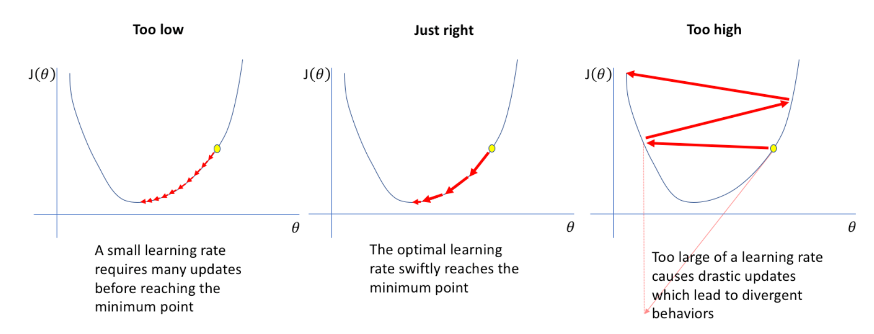
Learning rate
Hyper parameter
Generally, between 0 to 1
It defines how quickly the model converges to global minima

Slide 13
Vanishing vs exploding gradient
Vanishing Gradient: Derivative of loss function is small
Exploding Gradient: Derivative of loss function is large

Slide 14
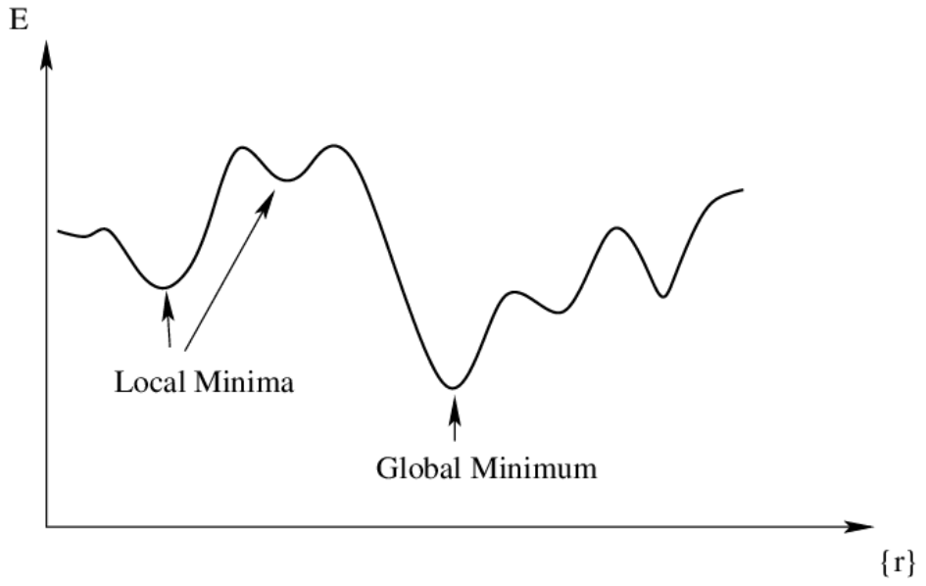
Global vs local Minima

Slide 15
How good is your model?
Bias:
Variance:
Difference between average prediction of model and correct value we are trying to predict
Ability of model prediction for a given data points or a value which tells us spread of data
$$A=πr^{2}L$$
Bias-Variance Tradeoff:
Model with low bias and low variance avoids both underfitting and overfitting

Slide 16
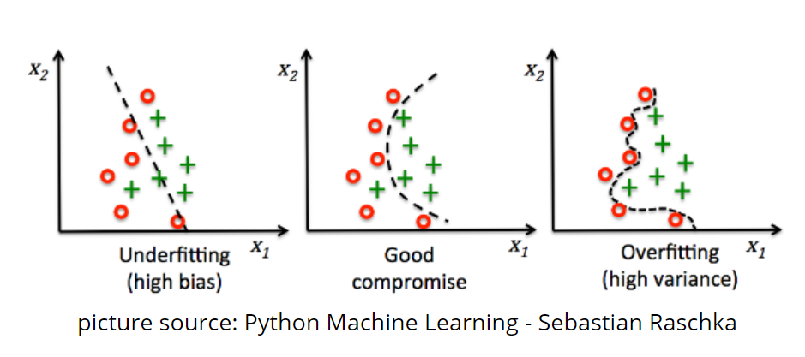
Bias-variance tradeoff
$$A=πr^{2}L$$

Slide 17
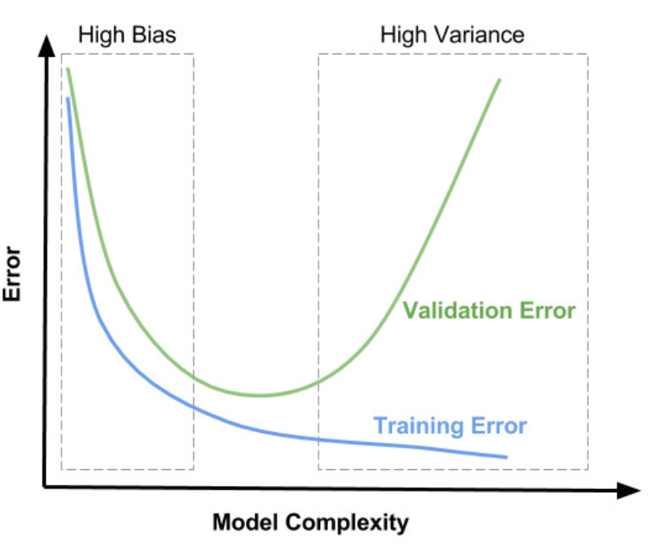
Bias-variance tradeoff
$$A=πr^{2}L$$

Slide 18
Regularization
Technique used for tuning the function by adding an additional penalty term in the error function.
The additional term controls the excessively fluctuating function.
Types:
$$A=πr^{2}L$$
L1-regularization
L2-regularization
Dropout

Slide 19
L1-Regularization
Let's consider simple model:
Y = wx+b
Loss (L) = Error(Y, Y_hat) = (wx+b-y_hat)**2
Loss with L1 regularization:
L1 = (wx+b-y_hat)**2 + ለ(|w|)
$$A=πr^{2}L$$

Slide 20
L2-Regularization
Let's consider simple model:
Y = wx+b
Loss (L) = Error(Y, Y_hat) = (wx+b y_hat)**2
Loss with L2 regularization:
L2 = (wx+b-y_hat)**2 + ለ(w**2)
$$A=πr^{2}L$$

Slide 21
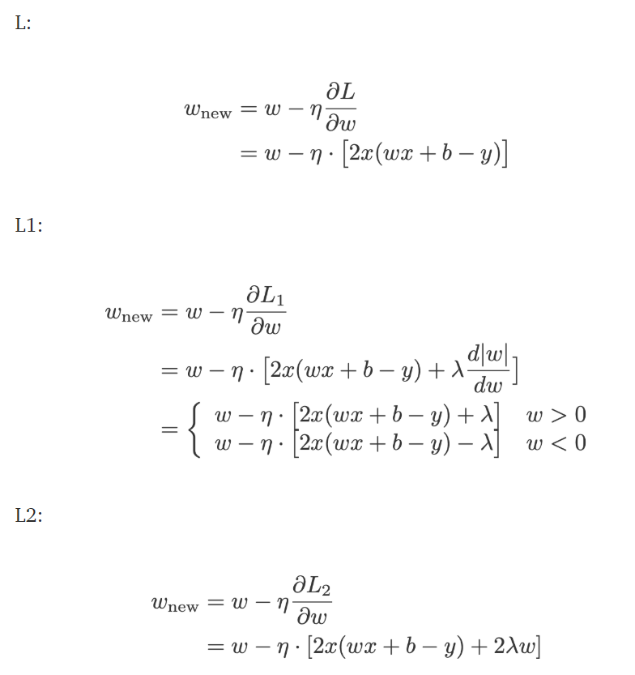
How overfitting prevented Using Regularization?
$$A=πr^{2}L$$

Slide 22
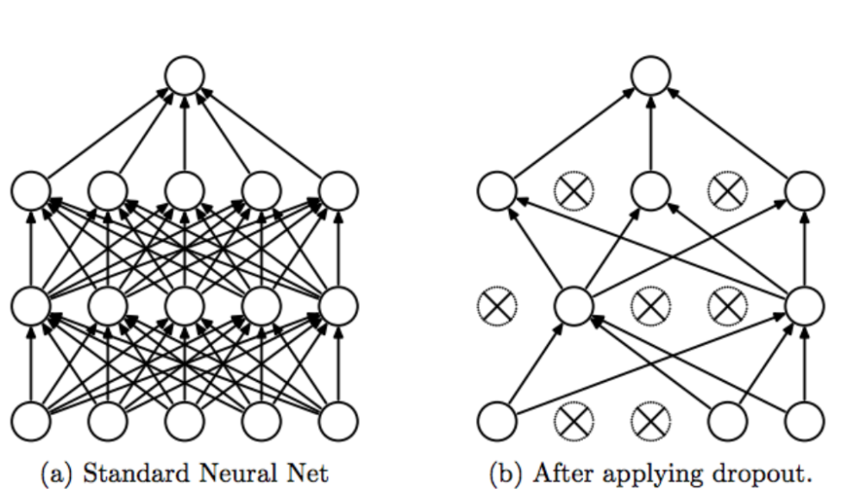
Dropout
Dropout technique works by randomly reducing the number of interconnected neurons within a neural network.
$$A=πr^{2}L$$

Slide 23
Next
Tensorflow basic: NN layers, compile, fit (training), loss function, optimizer, overfitting, underfitting
$$A=πr^{2}L$$

